Slide 1
SaML
Jesse van Bekkum

Slide 2
Why Single sign on?
Easy for users
Centralized security
Global two factor authentication

Slide 3
Protocols
Kerberos
Oauth
OpenID/OpenID Connect
JSON Web Token (JWT)
Security Assertion Markup Language (SAML)

Slide 4
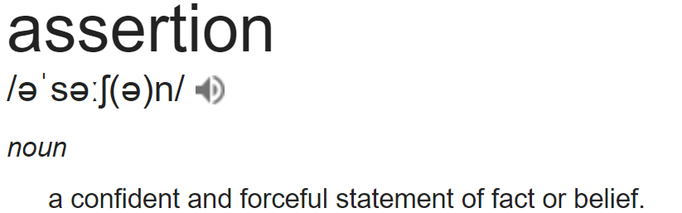
What is saml
Security Assertion Markup Language
Notes:
Compare to passport, passport supplies facts asserted by the Dutch government

Slide 5
What is Saml
Open standard by OASIS
Federation protocol
Metadata

Slide 6
Federation
One or more Identity Providers
Multiple Service providers
Service providers trust the assertions made by the identity providers

Slide 7
Identity providers
OpenAM
NetIQ
Oracle Access Manager
Microsoft Identity Manager
Notes:
Most important factor in choosing a SSO protocol

Slide 8
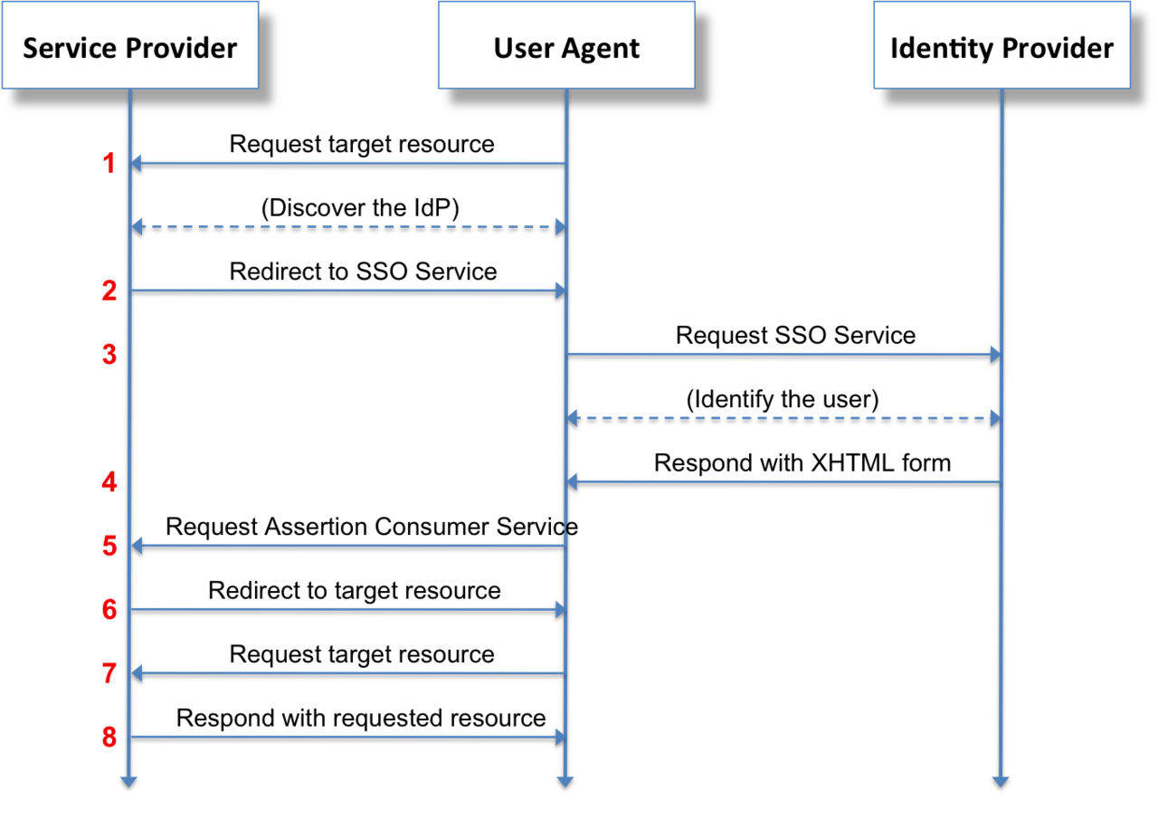
In detail

Slide 9
Profiles
WebSSO
ECP Profile
Single log out profile

Slide 10
Advantages
Standard
Old and well tested
Vendor support
Libraries in many languages

Slide 11
Disadvantages
XHTML form posts
Require page changes

Slide 12

Demonstration

